Slide 1


Willson Financial Database Design: Streamlining Asset and Client Management
Willson Financial, a prominent financial services company, sought to revolutionize its management of client assets, transactions, billings, and compliance. Our team of experts was tasked with designing a comprehensive database system to address these critical aspects of their operations. This presentation outlines our innovative solution, detailing the intricate business rules, carefully considered assumptions, and the resulting entity-relationship diagram that forms the backbone of this transformative system.
Through our meticulous design and implementation, Willson Financial is now poised to streamline its operations, enhance client satisfaction, and ensure robust compliance with regulatory requirements. Join us as we explore the intricacies of this game-changing database solution that's set to redefine financial service management.

Slide 2

Project Group 3 Team
Harrison Futch
Hi, my name is Harrison Futch. I have been working with Walt Disney Resort for almost two years. I am looking to go into Imagineering for Software Development as that is the degree I am pursuing with Bellevue University. I have four years of college experience with Cybersecurity and basic software development.
Shayna Solomon
Hi, my name is Shayna Solomon. I have been working for a promotional advertising company since 2019. I am currently getting my bachelor's in software development from Bellevue University, and I am excited to see what the future brings.

Slide 3

Crafting the Business Rules
1
Client Management
We established a robust client management system with unique client IDs, comprehensive personal details, and the ability to handle both individual and corporate clients. This system allows for multiple assets and transactions to be associated with each client, providing a complete financial overview.
2
Asset and Transaction Management
Our design incorporates unique identifiers for each asset and transaction, ensuring accurate tracking and management. Assets are linked to specific clients and include important details such as type, value, and acquisition date. Transactions are meticulously recorded with client ID, date, amount, and type.
3
Employee and Billing Management
The system includes a comprehensive employee management module with unique employee IDs, detailed information, and specific role assignments. The billing management system is designed to generate accurate billing records based on client transactions and assets, with each billing record having a unique identifier.
4
Compliance Integration
To ensure adherence to SEC regulations, we integrated robust compliance features. These allow the compliance manager to maintain necessary records, conduct regular audits, and ensure all company activities meet regulatory requirements.

Slide 4

Understanding Willson Financial's Needs
1
Comprehensive Client Management
Willson Financial required a system that could handle both individual and corporate clients, managing their unique identifiers, personal details, and total asset values. The system needed to accommodate multiple assets and transactions per client, ensuring a holistic view of each client's financial portfolio.
2
Robust Asset and Transaction Tracking
The ability to meticulously track and manage assets and transactions was paramount. Each asset and transaction needed a unique identifier, with assets linked to specific clients and transactions including crucial details such as date, amount, and type.
3
Efficient Billing and Employee Management
The system had to support a sophisticated billing structure based on client transactions and assets. Additionally, it needed to manage employee information, roles, and responsibilities effectively to ensure smooth operations and clear accountability.
4
Stringent Compliance Adherence
Given the regulatory environment of financial services, the system had to be designed with compliance at its core. This included features to maintain records, conduct audits, and ensure all activities met SEC requirements.

Slide 5
Key Assumptions Guiding Our Design
Client Diversity
Transaction and Asset Complexity
Regulatory Landscape
Our design assumes a diverse client base, including both individuals and corporate entities. This flexibility allows Willson Financial to cater to a wide range of clients without compromising on data integrity or management capabilities. We've ensured that the system can handle the unique requirements of each client type efficiently.
Our design assumes a dynamic regulatory environment. We've built in flexibility to adapt to changing SEC requirements and other financial regulations. This forward-thinking approach ensures that Willson Financial can remain compliant without major system overhauls, even as the regulatory landscape evolves.
We've designed the system to handle a wide variety of transaction types and asset classes. This assumption allows for future scalability and ensures that Willson Financial can manage complex financial portfolios without needing significant system changes. The system is prepared to handle everything from simple cash deposits to complex derivative transactions.

Slide 6

Generating Actionable Reports
1
Client Transaction Summary
2
Asset Management Report
3
Employee Role Summary
4
Billing Summary Report
This report outlines the roles and responsibilities of each employee, including their contact information. It's invaluable for management to ensure proper task allocation, identify skill gaps, and maintain clear communication channels within the organization.
Summarizing billing records for each client, this report includes billing dates, amounts, and types. It's crucial for finance teams to track revenue, ensure accurate invoicing, and identify any discrepancies or patterns in billing that may require attention or optimization.
This report provides a comprehensive overview of each client's transactions. It includes transaction dates, amounts, and types, offering a clear picture of the client's financial activity. This summary is crucial for account managers to track client behavior and identify potential investment opportunities or areas of concern.
Detailing the assets managed for each client, this report includes asset types, values, and acquisition dates. It's an essential tool for financial advisors to assess portfolio diversity and performance, enabling them to make informed recommendations for asset allocation and rebalancing strategies.

Slide 7

Future-Proofing Willson Financial
Scalability
Our database design is built to scale, accommodating Willson Financials' growth. As the client base expands and transaction volumes increase, the system will maintain its performance and efficiency, ensuring seamless operations well into the future.
Adaptability
The modular nature of our design allows for easy integration of new financial products or services. Whether it's incorporating cryptocurrency assets or adapting to new regulatory requirements, the system is flexible enough to evolve with the changing financial landscape.
Data Security
With increasing cyber threats, our system incorporates state-of-the-art security measures. Regular security updates and audits are built into the design, ensuring that Willson Financials' sensitive financial data remains protected against emerging threats.
AI Integration
The database is designed with future AI integration in mind. As AI technology advances, Willson Financial can easily incorporate predictive analytics, automated compliance checks, and personalized client recommendations, staying at the forefront of financial technology.

Slide 8
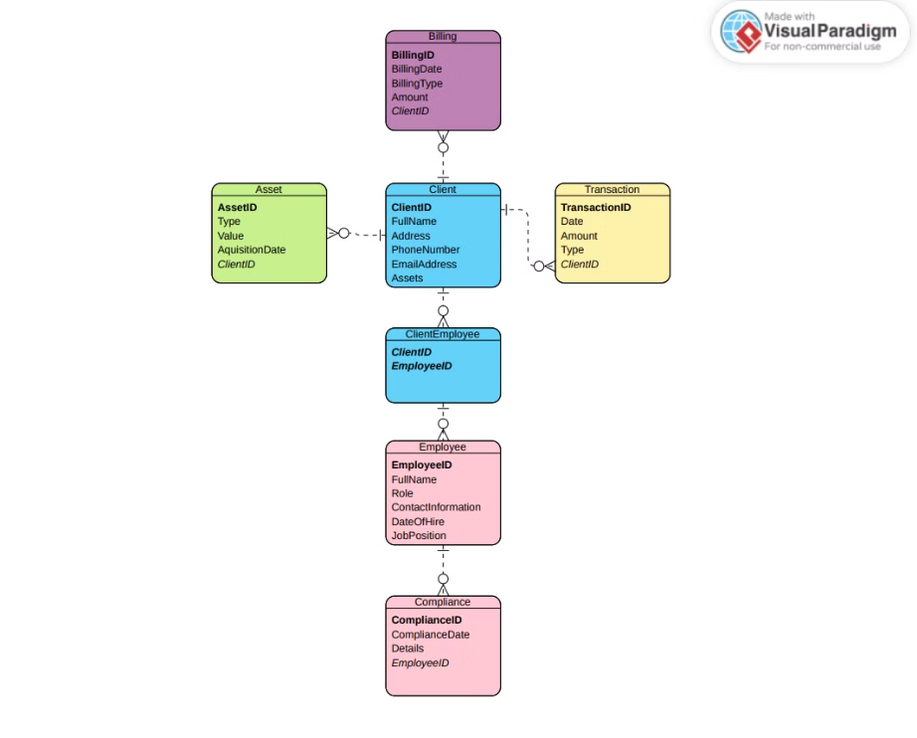
Entity Relationship Diagram

Slide 9
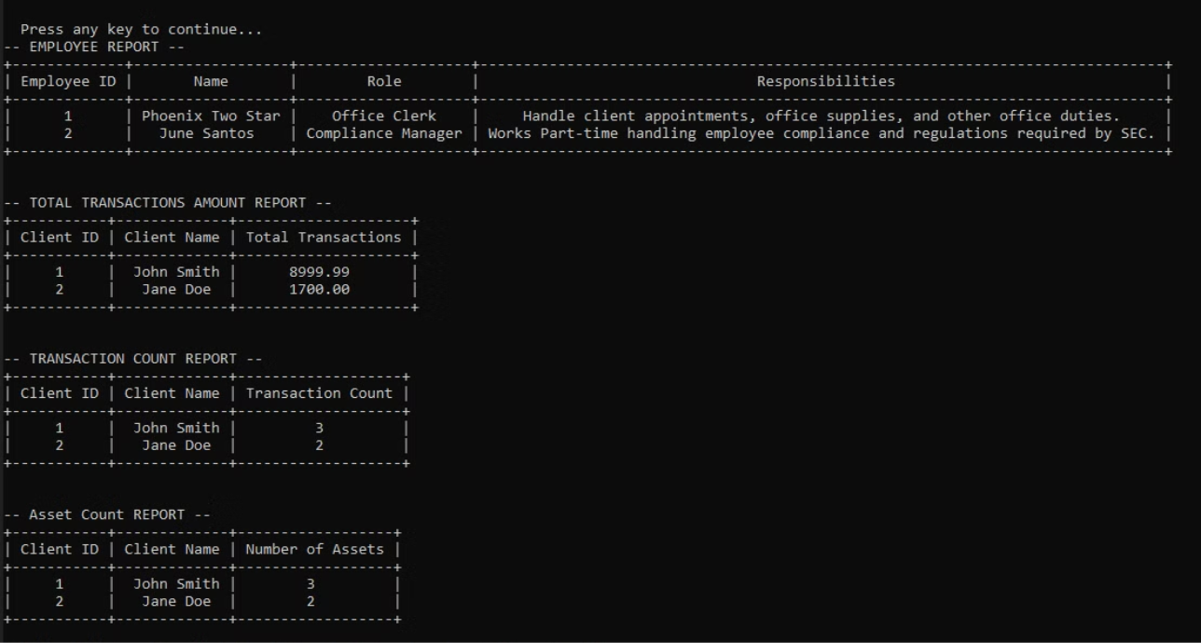

Slide 10
db_info_insert.sql
-- if database exists, drop it DROP USER IF EXISTS 'wilson_user'@'localhost';
-- create wilson_user and grant all privileges to the new database -- grant all privileges to the wilson financial database to user wilson_user on localhost CREATE USER 'wilson_user'@'localhost' IDENTIFIED BY 'secure_password'; GRANT ALL PRIVILEGES ON wilsonfinancial.* TO 'wilson_user'@'localhost'; FLUSH PRIVILEGES;
USE WilsonFinancial;
/* ADD RECORDS */
/* Clients */ INSERT INTO Clients (ClientID, Name, ContactInfo, EmployeeID) VALUES(1, 'John Smith', "johnsmith123@gmail.com", NULL);
INSERT INTO Clients (ClientID, Name, ContactInfo, EmployeeID) VALUES(2, 'Jane Doe', "janedoe456@gmail.com", NULL);
/* Assets */
INSERT INTO Assets (AssetID, AssetType, AssetValue, AcquisitionDate, ClientID) VALUES(1, 'Painting', 5000.0, '2023-05-25', 1);
INSERT INTO Assets (AssetID, AssetType, AssetValue, AcquisitionDate, ClientID) VALUES (2, 'Computer', 1999.99, '2024-01-12', 1);
INSERT INTO Assets (AssetID, AssetType, AssetValue, AcquisitionDate, ClientID) VALUES (3, 'Desk', 500.0, '2024-04-08', 2);
INSERT INTO Assets (AssetID, AssetType, AssetValue, AcquisitionDate, ClientID) VALUES (4, 'Painting', 1200.0, '2023-12-31', 2);
INSERT INTO Assets (AssetID, AssetType, AssetValue, AcquisitionDate, ClientID) VALUES (5, '4k-TV', 2000.0, '2024-06-12', 1);
/* Transactions */ INSERT INTO Transactions (TransactionID, TransactionAmount, TransactionDate, ClientID) VALUES (1, 500.0, '2024-07-10', 1);
INSERT INTO Transactions (TransactionID, TransactionAmount, TransactionDate, ClientID) VALUES (2, 1200.0, '2024-07-15', 2);
INSERT INTO Transactions (TransactionID, TransactionAmount, TransactionDate, ClientID) VALUES (3, 700.0, '2024-07-20', 1);
INSERT INTO Transactions (TransactionID, TransactionAmount, TransactionDate, ClientID) VALUES (4, 200.0, '2024-07-25', 2);
/* Employees */ INSERT INTO Employees (EmployeeID, Name, Role, Responsibilities) VALUES (1, 'Michael Scott', 'Manager', 'Manage operations');
INSERT INTO Employees (EmployeeID, Name, Role, Responsibilities) VALUES (2, 'Dwight Schrute', 'Sales', 'Handle client sales');
INSERT INTO Employees (EmployeeID, Name, Role, Responsibilities) VALUES (3, 'Pam Beesly', 'Receptionist', 'Manage front desk');
INSERT INTO Employees (EmployeeID, Name, Role, Responsibilities) VALUES (4, 'Jim Halpert', 'Sales', 'Handle client sales');
/* Billing */ INSERT INTO Billing (BillingID, ClientID, BillingDate, BillingAmount, BillingType) VALUES (1, 1, '2024-08-01', 150.0, 'Monthly Fee');
INSERT INTO Billing (BillingID, ClientID, BillingDate, BillingAmount, BillingType) VALUES (2, 2, '2024-08-01', 300.0, 'Monthly Fee');

Slide 11
Sql_reports.py
import mysql.connector from mysql.connector import errorcode import prettytable from prettytable import PrettyTable: # Reference(s) for PrettyTable: # https://tech.joellemena.com/python/python-print-sql-query-results-as-table/ # https://www.geeksforgeeks.org/creating-tables-with-prettytable-library-python/ config = { "user": "root", "password": "7#x2X_p?q35x6!X", "host": "127.0.0.1", "database": "wilsonfinancial", "raise_on_warnings": True } try: db = mysql.connector.connect(**config) print("\n Database user {} connected to MySQL on host {} with database {}".format(config["user"], config["host"], config["database"])) input("\n\n Press any key to continue...") cursor = db.cursor() ## Report 1: List of Employees and their Roles and Responsibilities ## query1 = "SELECT EmployeeID, Name, Role, Responsibilities FROM Employees;" ## Report 2: Client total Transaction Amount ## query2 = "SELECT c.ClientID, c.Name, SUM(t.TransactionAmount) AS TotalTransactionAmount FROM Clients c JOIN Transactions t ON c.ClientID = t.ClientID GROUP BY c.ClientID, c.Name ORDER BY TotalTransactionAmount DESC;" # ## Report 3: Clients with High Transaction Volume ## query3= "SELECT c.ClientID, c.Name, COUNT(t.TransactionID) AS TransactionCount FROM Clients c JOIN Transactions t on c.ClientID = t.ClientID GROUP BY c.ClientID, c.Name HAVING TransactionCount < 10 ORDER BY TransactionCount DESC;" ## Report 4: Number of Assets each client has Aquired ## query4 = "SELECT a.ClientID, c.Name, COUNT(a.AssetID) AS NumberOfAssets FROM Assets a JOIN Clients c ON a.ClientID = c.ClientID GROUP BY a.ClientID, c.Name ORDER BY NumberOfAssets DESC;" employeeTable = PrettyTable() transactionsTable = PrettyTable() countTable = PrettyTable() assetTable = PrettyTable() cursor.execute(query1) employeeReport = cursor.fetchall() ## EMPLOYEE REPORT ## print("-- EMPLOYEE REPORT --") employeeTable.field_names = ["Employee ID", "Name", "Role", "Responsibilities"] for employee in employeeReport: employeeTable.add_row(employee) print(employeeTable) print("\n") ## TOTAL TRANSACTION AMOUNT REPORT ## cursor.execute(query2) totalReport = cursor.fetchall() print("-- TOTAL TRANSACTIONS AMOUNT REPORT --") transactionsTable.field_names = ["Client ID", "Client Name", "Total Transactions"] for total in totalReport: transactionsTable.add_row(total) print(transactionsTable) print("\n") ## TOTAL TRANSACTION COUNT REPORT ## cursor.execute(query3) countReport = cursor.fetchall() print("-- TRANSACTION COUNT REPORT --") countTable.field_names = ["Client ID", "Client Name", "Transaction Count"] for count in countReport: countTable.add_row(count) print(countTable) print("\n") ## Total numnber of assets per client ## cursor.execute(query4) assetReport = cursor.fetchall() print("-- Asset Count REPORT --") assetTable.field_names = ["Client ID", "Client Name", "Number of Assets"] for asset in assetReport: assetTable.add_row(asset) print(assetTable) except mysql.connector.Error as err: if err.errno == errorcode.ER_ACCESS_DENIED_ERROR: print(" The supplied username or password are invalid") elif err.errno == errorcode.ER_BAD_DB_ERROR: print(" The specified database does not exist") else: print(err) finally: cursor.close() db.close()

